Slide 1
Timing Diagram
Representation of Various Control signals generated during Execution of an Instruction.
Following Buses and Control Signals must be shown in a Timing Diagram:
Higher Order Address Bus.
Lower Address/Data bus
ALE
RD
WR
IO/M

Slide 2
Timing Diagram is a graphical representation. It represents the execution time taken by each instruction in a graphical format. The execution time is represented in T-states.
Instruction Cycle:
The time required to execute an instruction .
Machine Cycle:
The time required to access the memory or input/output devices .
T-State:
The machine cycle and instruction cycle takes multiple clock periods.
A portion of an operation carried out in one system clock period is called as T-state.

Slide 3
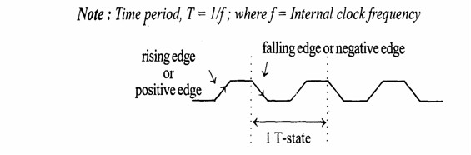

Slide 4
Timing diagrams
The 8085 microprocessor has 7 basic machine cycle. They are
Op-code Fetch cycle(4T).
Memory read cycle (3T)
Memory write cycle(3T)
I/O read cycle(3T)
I/O write cycle(3T)
Interrupt Acknowledge cycle(6T or 12T)
Bus idle cycle
collected by C.Gokul AP/EEE,VCET

Slide 5
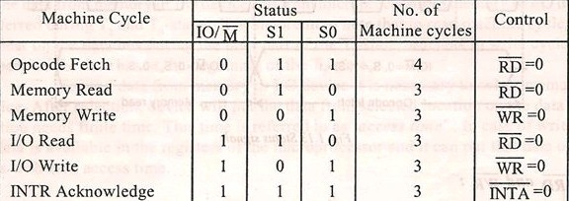
collected by C.Gokul AP/EEE,VCET

Slide 6
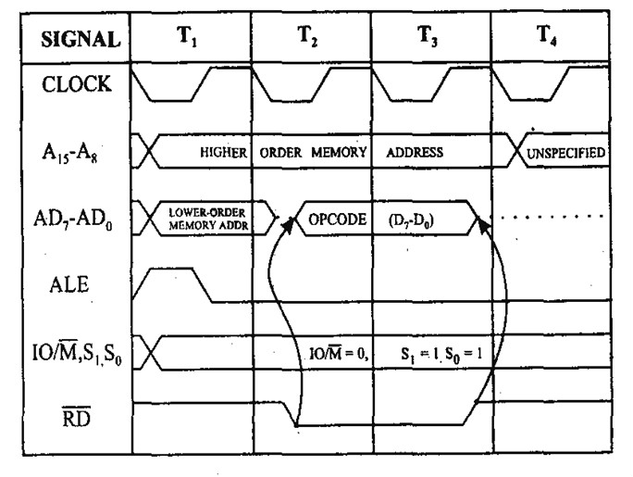
1.Opcode fetch cycle(4T)

Slide 7
1 The Opcode fetch cycle
Fetches the instructions from memory and delivers it to the instruction register of the microprocessor
Opcode fetch machine cycle consists of 4 T-states.
•
T1 State:
During the T1 state, the contents of the program counter are
placed on the 16 bit address bus.
The higher order 8 bits are transferred to address bus (A8- A15) and lower order 8 bits are transferred to multiplexed A/D (AD0-AD7) bus.
ALE (address latch enable) signal goes high. As soon as ALE goes high, the memory latches the AD0-AD7 bus.
At the middle of the T state the ALE g oes low

Slide 8
T2 State:
During the beginning of this state, the RD’ signal goes low to enable memory. It is during this state, the selected memory location is placed on D0-D7 of the Address/Data multiplexed bus.
T3 State:
In the previous state the Opcode is placed in D0-D7 of the A/D bus. Now the RD’ goes high after this action and thus disables the memory from A/D bus.
T4 State:
In this state the Opcode which was fetched from the memory is decoded.
collected by C.Gokul AP/EEE,VCET

Slide 9
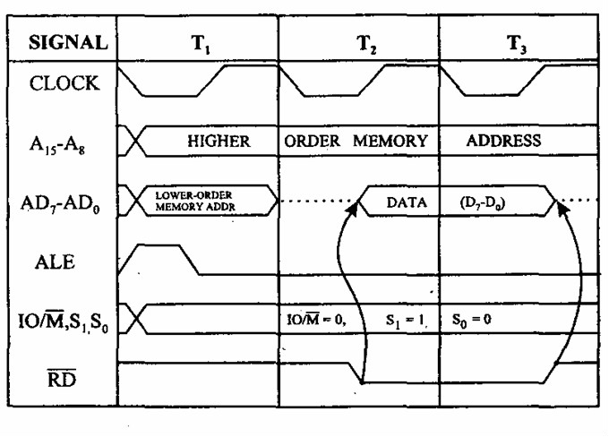
2. Memory read cycle (3T)

Slide 10
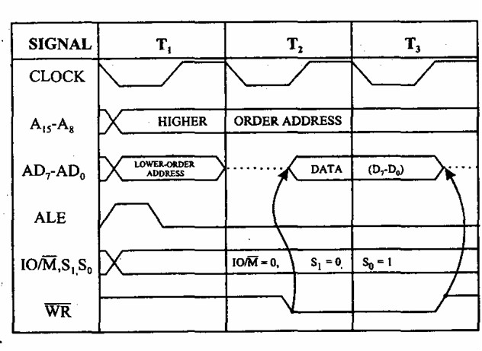
3. Memory write cycle (3T)

Slide 11
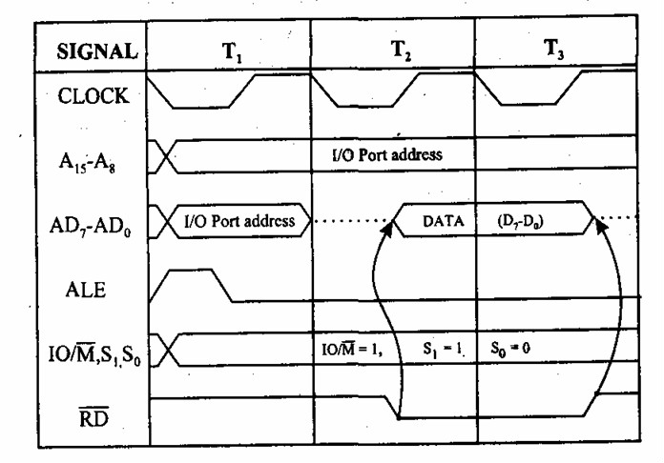
4.I/O read cycle(3T)

Slide 12
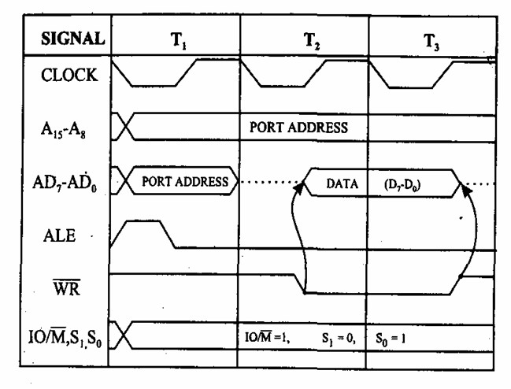
5.I/O write cycle(3T)

Slide 13
Timing Diagram
Instruction: A000h
MOV A,B
Corresponding Coding: A000h 78

Slide 14
Timing Diagram
Instruction:
A000h MOV A,B
Corresponding Coding: A000h 78
T1
T2
T3
T4
A0h
A15- A8 (Higher Order Address bus)
00h 78h
Lower order bus AD0 to AD7
ALE
RD
78
OFC
WR
8085
Memory
IO/M
Op-code fetch Cycle

Slide 15
Timing Diagram
Instruction:
A000h MVI A,45h
Corresponding Coding:
A000h A001h
3E
45

Slide 16
Timing Diagram
Instruction:
A000h MVI A,45h
Corresponding Coding:
 | 3E 45
OFC
MEMR
A000h A001h
3E
45
8085
Memory

Slide 17
Timing Diagram
T1
T2
T3
T4
T5
T6
T7
A0h
A0h
A15- A8 (Higher Order Address bus)
00h 3Eh
AD7-AD0 (Lower order address/data Bus)
01h
45h
Instruction:
A000h MVI A,45h
Corresponding Coding:
ALE
A000h A001h
3E
45
RD
WR
IO/M
Op-Code Fetch Cycle
Memory Read Cycle

Slide 18
Timing Diagram
Instruction:
A000h LXI H, FO45h
Corresponding Coding:
A000h A001h A002h
21
45
F0

Slide 19
Timing Diagram
Instruction:
A000h LXI A,FO45h
Corresponding Coding:
OFC
MEMR
MEMR
A000h A001h A002h
21
45
F0
8085
Memory

Slide 20
Memory Read Cycle
Timing Diagram
Op-Code Fetch Cycle
Memory Read Cycle
T1
T2
T3
T4
T5
T6
T7
T8
T9
T10
A0h
A0h
A0h
A15- A8 (Higher Order Address bus)
00h
21h
01h
45h
02h
F0h
DA7-DA0 (Lower order address/data Bus)
ALE
RD
WR
IO/M

Slide 21
Timing Diagram
Instruction:
A000h MOV A,M
Corresponding Coding: A000h 7E

Slide 22
Timing Diagram
Instruction:
A000h MOV A,M
Corresponding Coding: A000h 7E
OFC
MEMR
8085
Memory

Slide 23
Timing Diagram
T1
T2
T3
T4
T5
T6 T7
Content Of Reg H
A0h
A15- A8 (Higher Order Address bus)
00h 7Eh
DA7-DA0 (Lower order address/data Bus)
Instruction:
A000h MOV A,M
Corresponding Coding: A000h 7E
L Reg
Content Of M
ALE
RD
WR
IO/M
Op-Code Fetch Cycle
Memory Read Cycle

Slide 24
Timing Diagram
Instruction:
A000h MOV M,A
Corresponding Coding: A000h 77

Slide 25
Timing Diagram
Instruction:
A000h MOV M,A
Corresponding Coding: A000h 77
OFC
MEMW
8085
Memory

Slide 26
Timing Diagram
T1
T2
T3
T4
T5
T6 T7
Content Of Reg H
A0h
A15- A8 (Higher Order Address bus)
00h 7Eh
DA7-DA0 (Lower order address/data Bus)
Instruction:
A000h MOV M,A
Corresponding Coding: A000h 77
L Reg
Content of Reg A
ALE
RD
WR
IO/M
Op-Code Fetch Cycle
Memory Write Cycle

Slide 27
I/O READ
4125 IN COH
4125 DB (OPCODE)
4126 CO (PORT ADDRESS)
CO ------ DATA(5EH) TO ACCUMULATOR

Slide 28
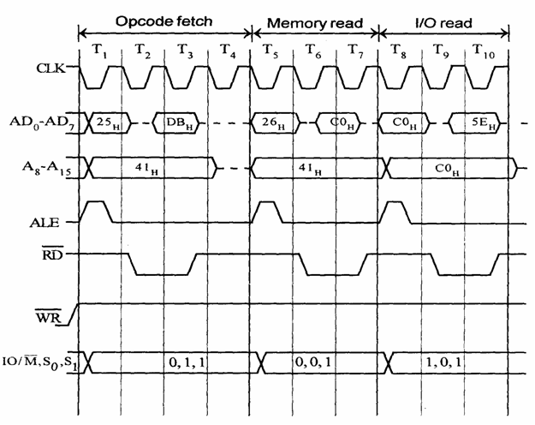

Slide 29
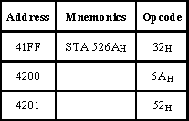
STA instruction
ex: STA 526A

Slide 30
It require 4 m/c cycles 13 T states
1.opcode fetch(4T) 2.memory read(3T) 3.memory read(3T) 4.Memory write(3T)
collected by C.Gokul AP/EEE,VCET

Slide 31
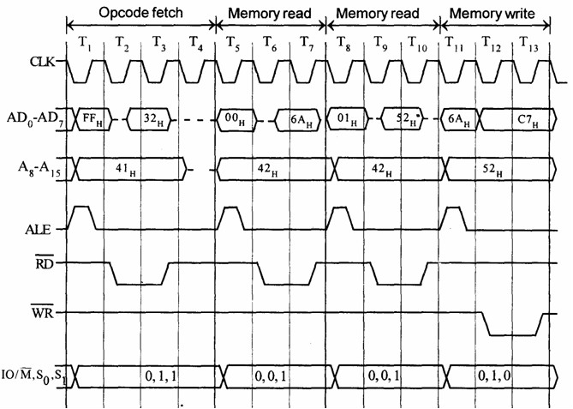

Slide 32
2000 INR M
2000 34H(OPCODE)
LXI H 5000 H
So 5000 is M
5000H SORE 26H

Slide 33
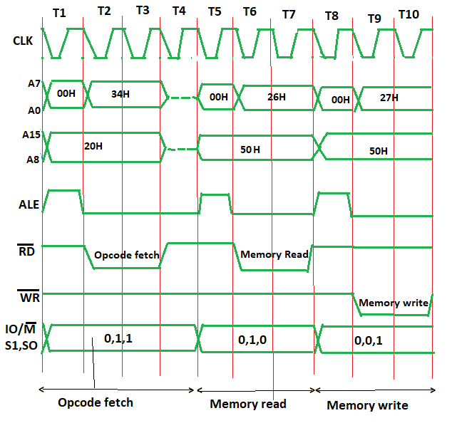
INR M

Slide 34
